Slide 1
SECTION 9 of the Rivers and Harbors Appropriation Act of 1899
ENVE 644
Environmental Management and Permitting

Slide 2
Notes:
Happy Earth Day!
Coincidence that our last enviro class is on earth day? I think not
Was created in response to a 1969 Santa Barbara oil spill
First earth day in 1970, same year as the passage of NEPA

Slide 3
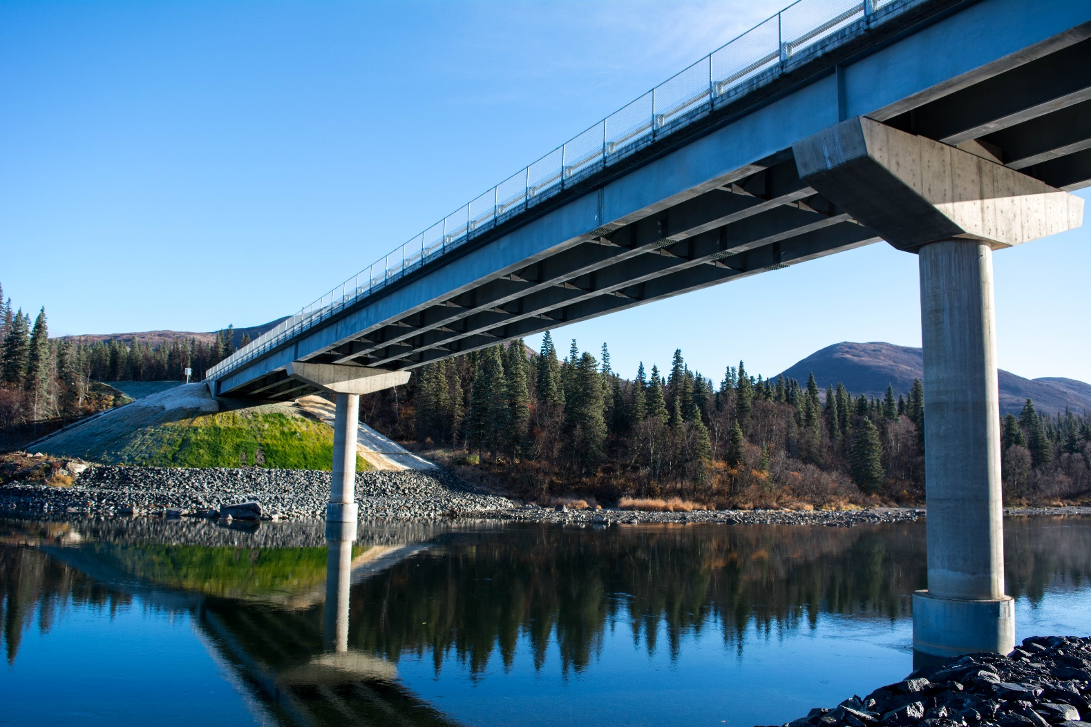
outline
Background
Jurisdiction
Permit Application Process
Example
References
Q&A
Wood River Bridge

Slide 4
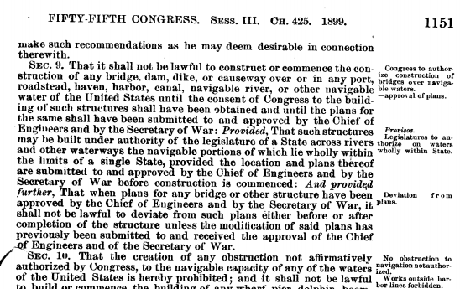
background
Bridge Act of August 18, 1894
33 U.S.C. 499
Rivers and Harbors Appropriation Act of 1899
33 U.S.C. 401, 403, 406, 502
Bridge Act of 1906
33 U.S.C. 491, 494, 495
Bridge Act of June 21, 1940 (Truman-Hobbs Act)
33 U.S.C. 511, 513, 514, 516, 517, 519, 521, 522, 523
General Bridge Act of August 2, 1946
33 U.S.C. 525 (except (c)), 528, 530, 533
International Bridge Act of September 26, 1972
33 U.S.C. 535(c), 535(e), 535(h)
https://www.loc.gov/law/help/statutes-at-large/55th-congress/session-3/c55s3ch425.pdf
Notes:
Many federal statues govern bridges
Rivers and Harbors Appropriation Act is the oldest federal environmental law
The act is part of a long list of legislation and appropriations dating back to 1824
Section 9 prohibits the construction of any bridge, dam, dike or causeway over or in navigable waterways
It is referred to as section 9 because that is how it was recorded in the statues-at-large of the 55th congress, 3rd session in 1899, section 9
The purpose of these Acts is to preserve the public right of navigation and to prevent interference with interstate and foreign commerce

Slide 5
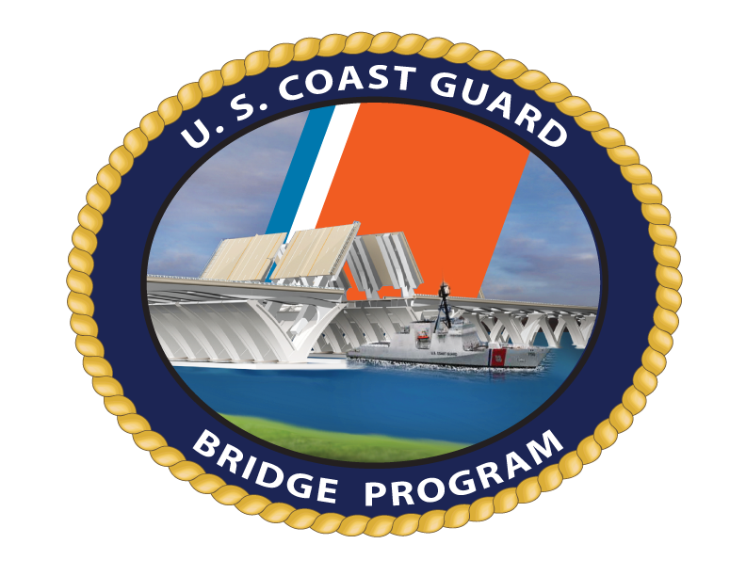
jurisdiction
Mission Statement
“To administer the various bridge statutes, environmental laws of the United States…”
Goals
“The Coast Guard monitors and ensures approximately 20,000 bridges crossing navigable waters of the United States are not unreasonable obstructions to navigation.”
Notes:
Bridge permitting was originally the responsibility of the US Army Corps of Engineers
In 1967, the Bridge Program was transferred from the Army Corps of Engineers to the Coast Guard within the Department of Transportation.
On 28 February 2003, the Coast Guard became an agency of the Department of Homeland Security.
Read mission statement and goals, more on navigable waters
The Coast Guard is responsible for approval of the location and plans of bridges and causeways constructed across navigable waters of United States
In addition, the Coast Guard is responsible for approval of the location and plans of international bridges and the alteration of bridges found to be unreasonable obstructions to navigation.
The Bridge Program carries out this responsibility by executing four functional areas
Permitting – issuing permits for construction or alteration of bridges over navigable waters.
Regulation – ensuring the operation of movable bridges meet the reasonable needs of navigation, and that all bridges are properly marked and lit to facilitate safe passage of vessels beneath.
Monitoring construction/maintenance/repair operations – coordinate waterway activities to ensure minimal impact to navigation.
Alteration – identifying bridges that are “unreasonable obstructions to navigation” as defined by the Truman-Hobbs Act, and ensuring that unused/abandoned bridges are removed.

Slide 6
contact
Mr. Clinton Scott Commander, Seventeenth
Coast Guard District (dpw) P. O. Box 25517 Juneau, AK 99802-5517 907-463-2276 Clinton.L.Scott@uscg.mil
https://www.dco.uscg.mil/Our-Organization/Assistant-Commandant-for-Prevention-Policy-CG-5P/Marine-Transportation-Systems-CG-5PW/Office-of-Bridge-Programs/District-Bridge-Contacts/
Notes:
The CG is divided into 2 areas and 9 districts
ak is pacific area, district 17

Slide 7
Navigable waters (33 CFR § 2.36)
Territorial seas of the United States;
Internal waters of the US subject to tidal influence; and
Internal waters of the US not subject to tidal influence that:
Are used as highways for substantial interstate or foreign commerce; or
waterway determined to be capable of improvement at a reasonable cost to provide as highways for substantial interstate or foreign commerce.
https://safety4sea.com/canadian-navigable-waters-act-comes-into-effect
Notes:
Navigability is defined as follows (read slide)
The current rewrite of WOTUS includes a change to the definition of “navigable waters”, mainly as it relates to discharges
If the applicant is uncertain whether or not a waterway is susceptible to improvements for navigation, is tidal, or is considered navigable, contact the Coast Guard to obtain information regarding a navigability determination.

Slide 8
Navigable waters district 17
Notes:
Alaska district list of waterways deemed by the USCG as being navigable
Wood River will come into play later when I show you an example
33 CFR Part 2: territorial seas and internal waters subject to tidal influence
PL 89-670 is the transfer from Dept of Army to Dept of Transpo

Slide 9
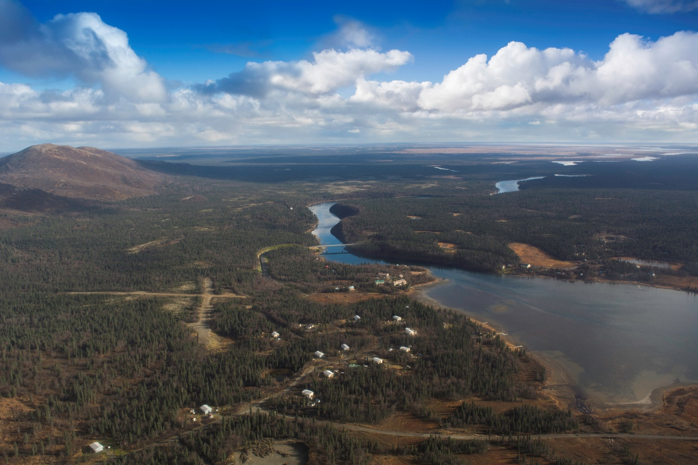
application considerations
Navigable Waters
Temporary Bridges
Time Limits
Bridge Protective Systems
Clearance Gauges
Approval of Falsework/Construction Procedures
Maintenance
Bridge Navigational Lighting
Notes:
Construct a new bridge or causeway, or Reconstruct or modify an existing bridge or causeway across navigable waters of the United States
Temporary repairs or replacement of severely deteriorated or damaged bridges or construction of new temporary bridges to meet emergency land transportation requirements may be authorized without a Coast Guard bridge permit.
Coast Guard bridge permits specify that the permit becomes null and void unless construction of the bridge is commenced and completed by certain dates. In the permit application, the applicant must consider the possible need for a bridge protective system that would promote safer navigation through the bridge.
The Coast Guard will review, coordinate and approve the proposed temporary navigational clearance restrictions through or under a bridge by use of falsework, pilings, floating equipment, closure of draws, or any work or activities which temporarily reduce the navigational clearances and design flood flows, including obstruction of any or all spans
Bridges constructed under a Coast Guard permit must be maintained in accordance with the applicable Bridge Act, permit conditions and approved plans
Bridges across waterways, which support nighttime navigation, are required to display navigational lights

Slide 10
Clearance
https://sustainableinfrastructure.org/project-awards/bayonne-bridge/
Notes:
This is probably the foremost criteria in bridge design and permitting
Guide Clearances are defined as the navigational clearances established by the Coast Guard for a particular navigable water of the United States which will ordinarily receive favorable consideration under the bridge permitting process (33 CFR Chapter 1, Subchapter J - Bridges) as providing for the reasonable needs of navigation. They are not intended to be regulatory in nature or to form a legal basis for approving or denying a bridge permit application.
Under the circumstances of a particular case, greater or lesser clearances for a proposed bridge may be required or approved as meeting the reasonable needs of navigation for that particular location.
USCG maintains a list of clearances for major waterbodies in the US, such as Mississippi River
They differ by reach
None in AK
Guide Clearances have not been established for all navigable waters of the United States. Where they do not exist, the horizontal and vertical clearances of proposed bridge projects necessary to meet the reasonable needs of the navigation are determined on a case by case basis

Slide 11
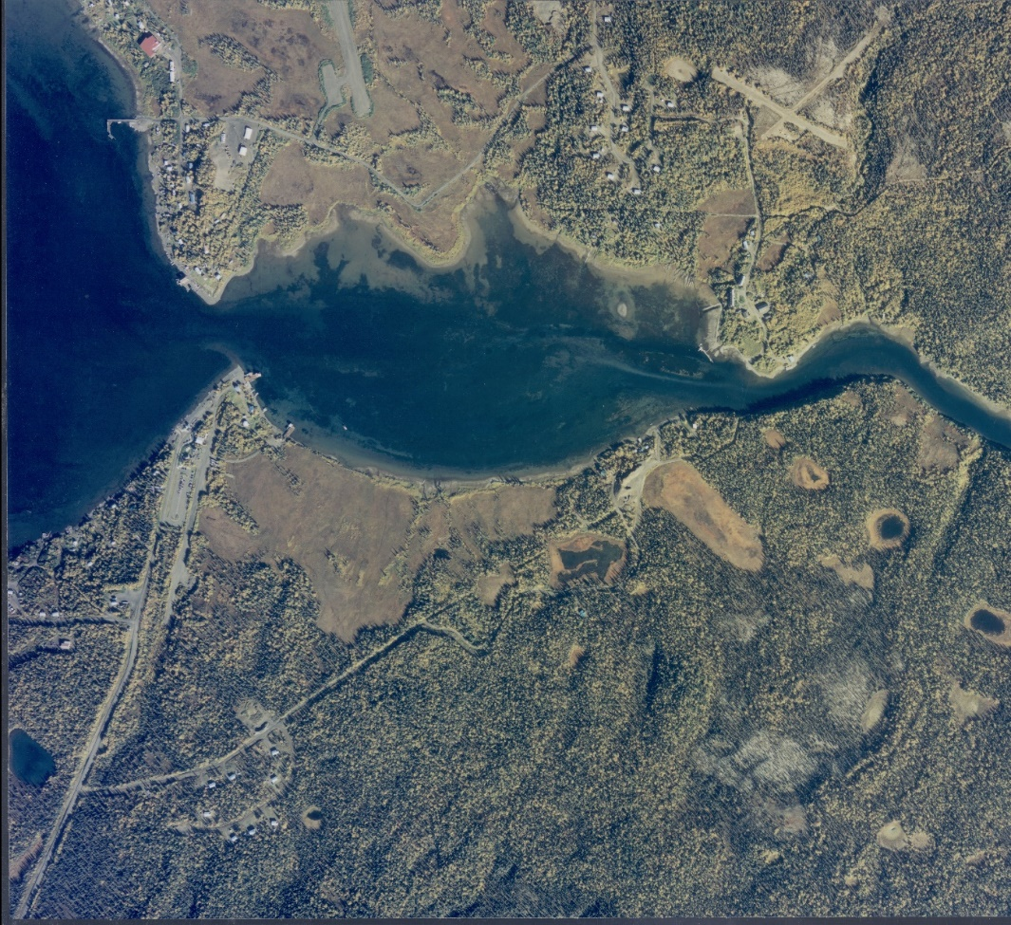
Wood river bridge
North Aleknagik
New Bridge
South Aleknagik
Feasibility study (1994-1995)
EA (1998-2004)
FONSI (2004)
Notes:
Let’s talk about an example project I was involved in that required a section 9 permit
DOT&PF project, FHWA funded
City of Aleknagik: ~300 residents, 2/3 north shore, 1/3 south shore
Gateway to Wood-Tikchik State Park
Safety (drownings, school children boated across)
Duplication of Community Services
Access to the existing road system
Timeline of project, continued on next slide

Slide 12
Design (2006-2017)
EA re-eval 1 (2011)
Section 9 permit application (2011-2013)
Bridge Construction (2014-2015)
EA re-eval 2 (2016)
Approach Road Construction (2017)
Notes:
First permit application was submitted on February 8th, 2011.
Second permit application was submitted on July 24th, 2012.
Community asked Governor Parnell for help with permit
Permit was issued on May 29th, 2013
20 years to from conception to construction, and over two years to obtain the permit

Slide 13
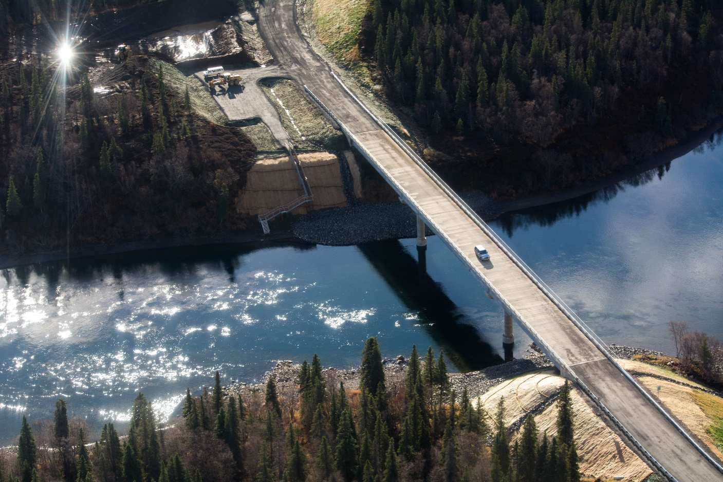
Environmental commitments
USCG: “A bridge should provide for reasonable navigation needs, i.e. clearance for the larger vessels plying Wood River and Lake Aleknagik.”
442 ft long
Three span
Min. vertical clearance 36 ft
Notes:
USCG clearance criteria obtained during scoping 1999
Verified during public involvement conducted during the permitting process

Slide 14
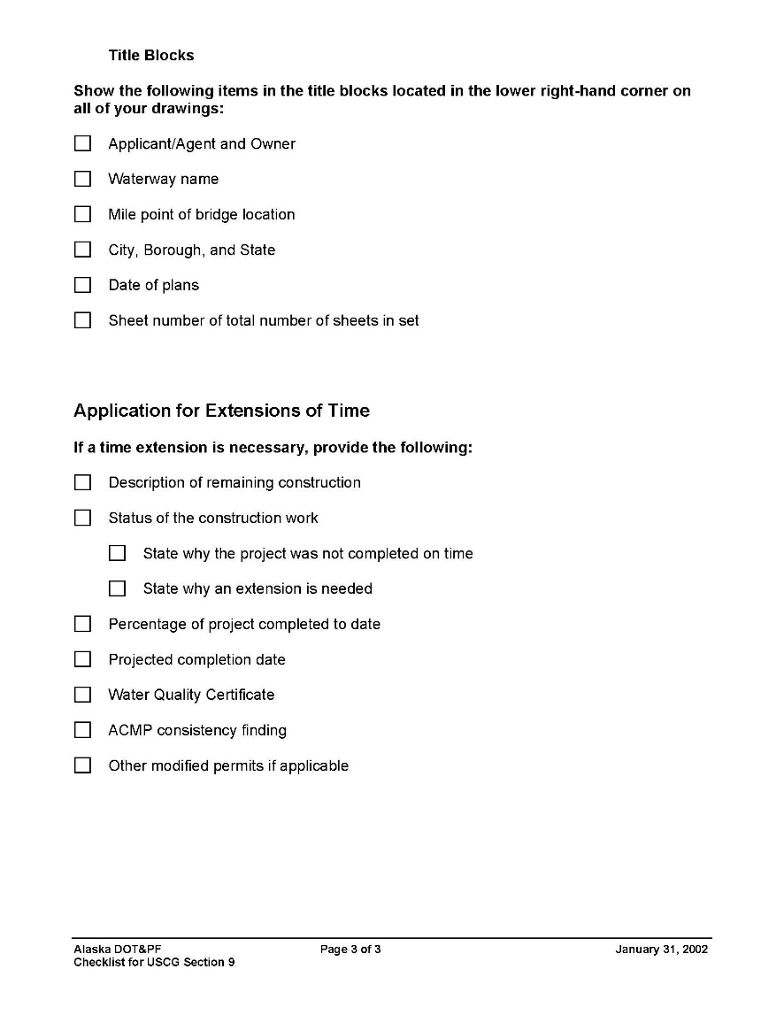
Permit application
Notes:
Final application was submitted on July 24th, 2012
DOT&PF has an application checklist (shown)
USCG has an applicant template
No application fee
Penalties (33 USC 406): deemed guilty of a misdemeanor, and on conviction thereof shall be punished by a fine not exceeding $2,500 nor less than $500, or by imprisonment not exceeding one year, or by both such punishments, in the discretion of the court.

Slide 15
Public notice
https://www.navcen.uscg.gov/?pageName=pnBridges
Notes:
Second permit application was submitted on July 24th, 2012.
Public Notice posted on July 31st, 2012
Comment period closed on August 30th, 2012
Permit wasn’t issued until May 29th, 2013
It states that the USCG would independently review the EA, meaning they could possibly require changes (why was this not done during the EA development?)
Public notices posted on USCG website (click on link)

Slide 16
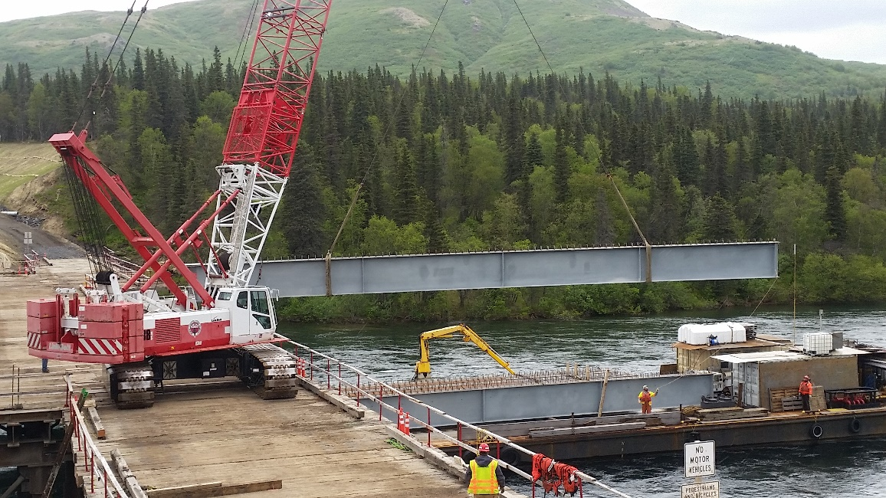
Permit
Permanent
bridge
Notes:
Seven page document, issued on May 29th, 2013
Permits the clearance envelope of 38’ high by 172’ wide
Conditions:
No deviations from submitted and approved plans
Comply with other laws/permits
Install fenders, if shown on plans (N/A in this example)
Clearance gauges
Submit final design plans to USCG prior to construction commencement
Remove permanent bridge after it is no longer used
Bridge construction has to start three years after issuance and be completed five years after issuance.

Slide 17
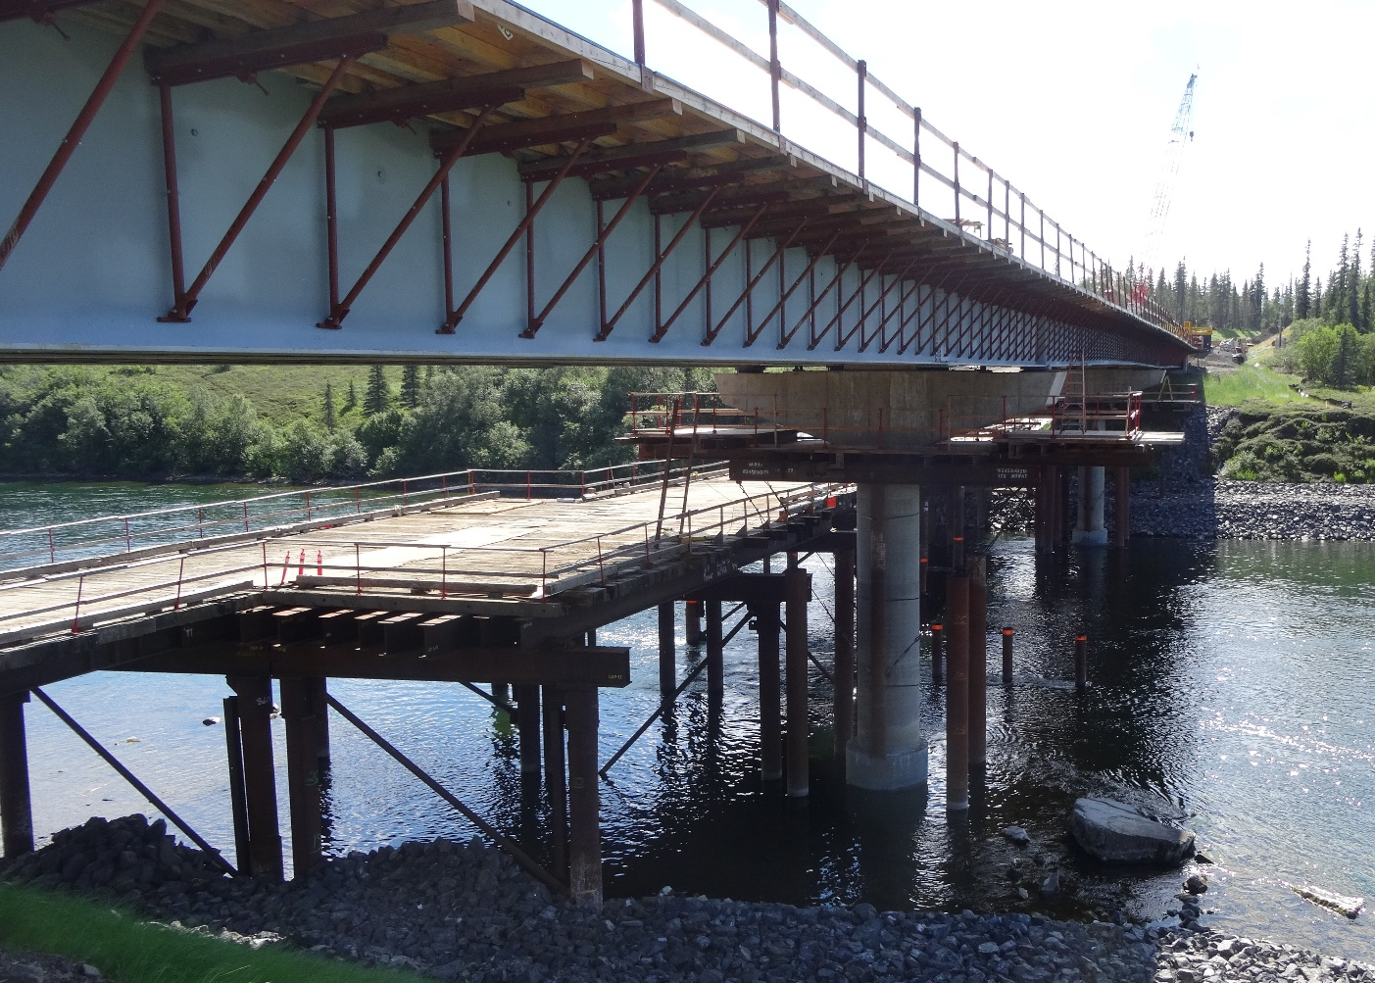
Permit
temporary
bridge
Notes:
Conditions:
Maintain navigability during construction, as shown on plans
Remove temp work no later than 90 days after bridge is open
Temp bridge vertical clearance 8’
The middle span was opened during winter shut down

Slide 18
Notes:
Time lapse, notice sudden appearance of girders

Slide 19
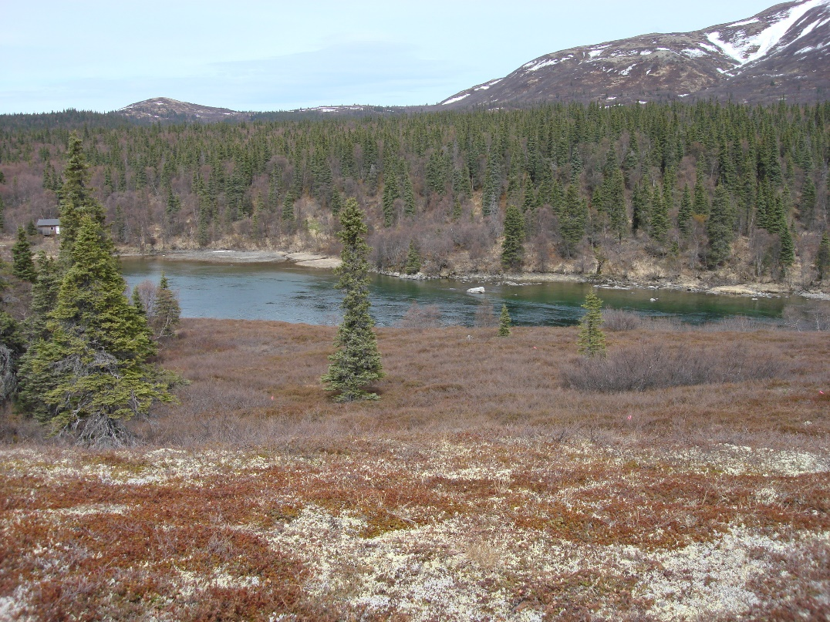
Before-after
Then
Now

Slide 20
references
USCG: https://www.dco.uscg.mil/Office-of-Bridge-Programs/
DOT&PF: http://dot.alaska.gov/stwddes/desenviron/resources/waters.shtml

Slide 21
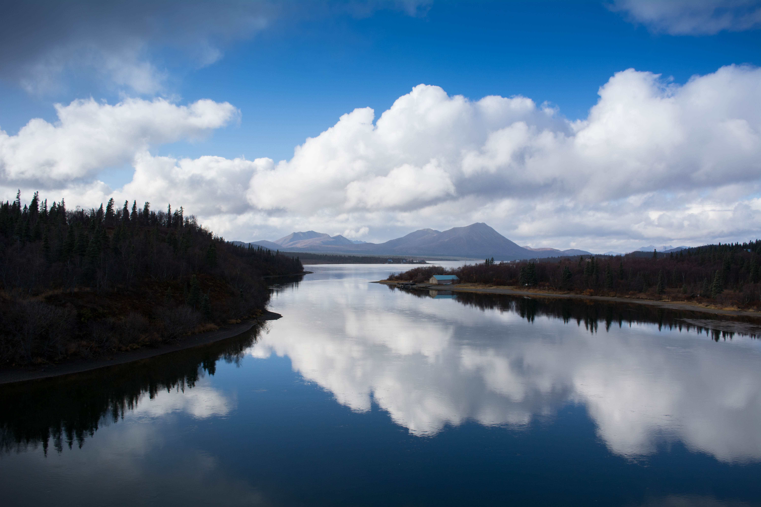
Thank you!
questions/comments?
Marc Frutiger, PE, PTOE
mfrutiger@Alaska.edu

